Slide 1
Longest Common Subsequence
Andreas Klappenecker

Slide 2
Subsequences
Suppose you have a sequence
X = < x₁,x₂,…,x_{m}>
of elements over a finite set S.
A sequence Z = < z₁,z₂,…,z_{k}> over S is called a subsequence of X if and only if it can be obtained from X by deleting elements.
Put differently, there exist indices i₁<i₂ <…<i_{k} such that
z_{a} = x_{ia}
for all a in the range 1<= a <= k.

Slide 3
Common Subsequences
Suppose that X and Y are two sequences over a set S.
We say that Z is a common subsequence of X and Y if and only if
Z is a subsequence of X
Z is a subsequence of Y

Slide 4
The Longest Common Subsequence Problem
Given two sequences X and Y over a set S, the longest common subsequence problem asks to find a common subsequence of X and Y that is of maximal length.

Slide 5
Naïve Solution
Let X be a sequence of length m,
and Y a sequence of length n.
Check for every subsequence of X whether it is a subsequence of Y, and return the longest common subsequence found.
There are 2^{m} subsequences of X. Testing a sequences whether or not it is a subsequence of Y takes O(n) time. Thus, the naïve algorithm would take O(n2^{m}) time.

Slide 6
Divide and Conquer
Can we use divide-and-conquer to solve this problem?

Slide 7
Dynamic Programming
Let us try to develop a dynamic programming solution to the LCS problem.

Slide 8
Prefix
Let X = < x₁,x₂,…,x_{m}> be a sequence.
We denote by X_{i} the sequence
X_{i} = < x₁,x₂,…,x_{i}>
and call it the i^{th} prefix of X.

Slide 9
LCS Notation
Let X and Y be sequences.
We denote by LCS(X, Y) the set of longest common subsequences of X and Y.

Slide 10
Optimal Substructure
Let X = < x₁,x₂,…,x_{m}>
and Y = < y₁,y₂,…,y_{n}> be two sequences.
Let Z = < z₁,z₂,…,z_{k}> is any LCS of X and Y.
If x_{m} = y_{n} then certainly x_{m} = y_{n} = z_{k}
and Z_{k-1} is in LCS(X_{m-1} , Y_{n-1})

Slide 11
Optimal Substructure (2)
Let X = < x₁,x₂,…,x_{m}>
and Y = < y₁,y₂,…,y_{n}> be two sequences.
Let Z = < z₁,z₂,…,z_{k}> is any LCS of X and Y.
If x_{m} <> y_{n} then x_{m} <> z_{k} implies that Z is in LCS(X_{m-1} , Y)
If x_{m} <> y_{n} then y_{n} <> z_{k} implies that Z is in LCS(X, Y_{n-1})

Slide 12
Overlapping Subproblems
If x_{m} = y_{n} then we solve the subproblem to find an element in LCS(X_{m-1} , Y_{n-1} ) and append x_{m}
If x_{m} <> y_{n} then we solve the two subproblems of finding elements in LCS(X_{m-1} , Y_{n-1} ) and LCS(X_{m-1} , Y_{n-1} ) and choose the longer one.

Slide 13
Recursive Solution
Let X and Y be sequences.
Let c[i,j] be the length of an element in LCS(X_{i}, Y_{j}).
c[i,j] =
0
if i=0 or j=0
c[i-1,j-1]+1
if i,j>0 and x_{i} = y_{j}
max(c[i,j-1],c[i-1,j])
if i,j>0 and x_{i} <> y_{j}

Slide 14
Dynamic Programming Solution
To compute length of an element in LCS(X,Y) with X of length m and Y of length n, we do the following:
Initialize first row and first column of the array c with 0.
Calculate c[1,j] for 1 <= j <= n,
c[2,j] for 1 <= j <= n …
Return c[m,n]
Complexity O(mn).

Slide 15
Dynamic Programming Solution (2)
How can we get an actual longest common subsequence?
Store in addition to the array c an array b pointing to the optimal subproblem chosen when computing c[i,j].

Slide 16
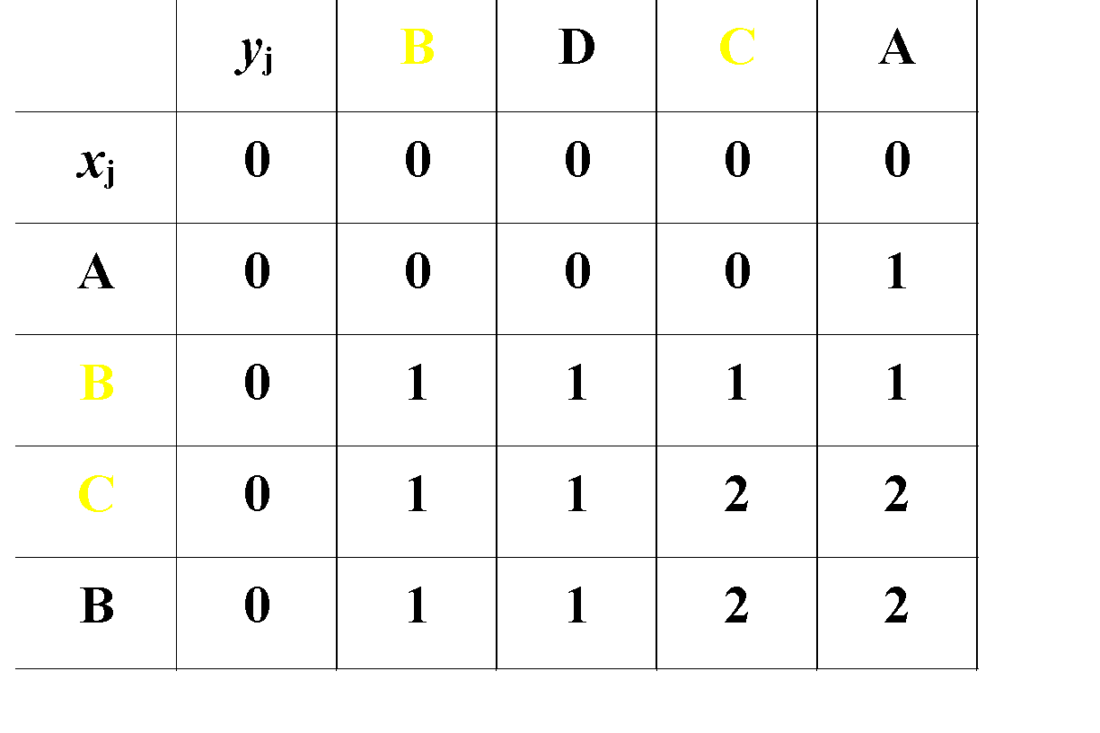
Example
Start at b[m,n]. Follow the arrows. Each diagonal array gives one element of the LCS.

Slide 17
Animation
http://wordaligned.org/articles/longest-common-subsequence

Slide 18
LCS(X,Y)
m ← length[X]
n ← length[Y]
for i ← 1 to m do c[i,0] ← 0
for j ← 1 to n do c[0,j] ← 0

Slide 19
LCS(X,Y)
for i ← 1 to m do for j ← 1 to n do if x_{i} = y_{j} c[i, j] ← c[i-1, j-1]+1 b[i, j] ← “D” else
if c[i-1, j] ≥ c[i, j-1] c[i, j] ← c[i-1, j] b[i, j] ← “U” else c[i, j] ← c[i, j-1] b[i, j] ← “L”
return c and b

Slide 20
END

